Slide 1
Microarchitectural Attacks and Defenses
Yuval Yarom
Ruhr University Bochum

Slide 2
Outline
About this course
Introduction to x86 assembly
Introduction to the design of modern CPUs

Slide 3
About This Course

Slide 4


Staff
Yuval Yarom
Email: yuval.yarom@rub.de
Office: MC 1/40 (temp)
Consulting: by appointment
Robbie Dumitru
Email: robert.dumitru@rub.de
Office: MC 1/48 (temp)
Consulting: by appointment

Slide 5
Admin
Time table
Lectures: Tuesday 10am-12pm IC 03/444-414
Tue 17.10.2023 IC 03/447
Tue 19.12.2023 IC 03/134
Possible move to MC later in the semester
Workshops: Wednesday 12-2pm GB 02/60

Slide 6
Admin
Time table
Lectures: Tuesday 10am-12pm IC 03/444-414
Tue 17.10.2023 IC 03/447
Tue 19.12.2023 IC 03/134
Possible move to MC later in the semester
Workshops: Wednesday 12-2pm GB 02/60
Assessment
Aiming for 5 practical projects
Program an attack/defense technique
Write about it

Slide 7

Registration
Max 30 students
Registration via FlexNow
No mark without registration
No lab access without registration
Lab access
Virtual lab, access via SSH
From your personal IP address (pip)
See https://noc.rub.de/web/services/pip
Register today to have a pip address tomorrow

Slide 8



A Sample Program
baseSqr = base * base
heightSqr = height * height
hypotenuse = sqrt(heightSqr + baseSqr)
Compile
asm
Execute

Slide 9
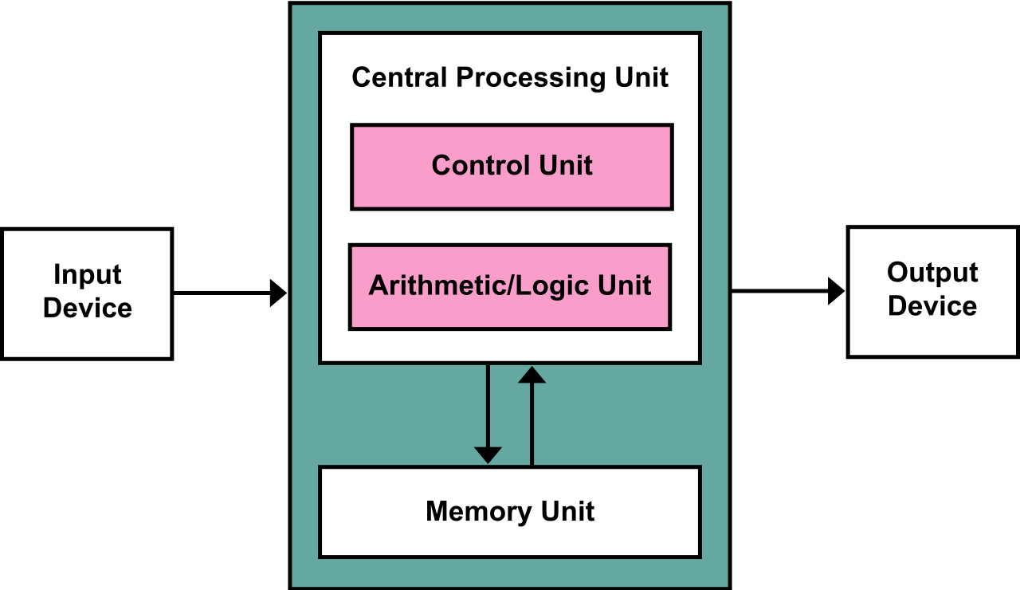
First Year Computer Science

Slide 10
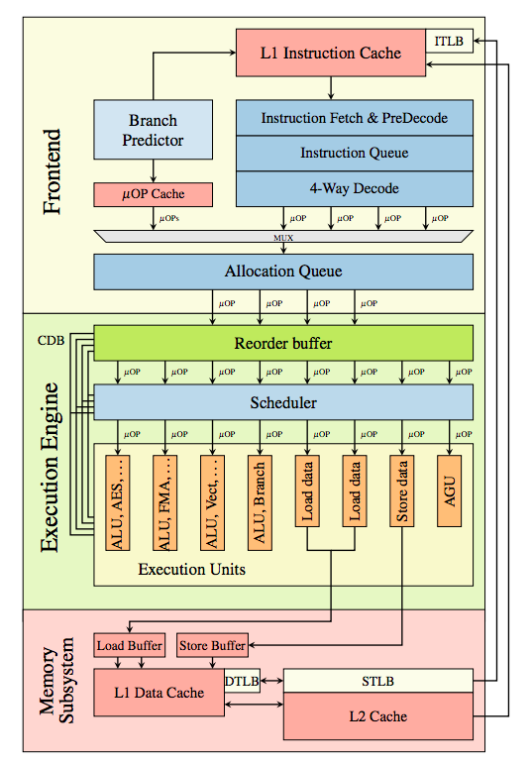
Computer Architecture Course

Slide 11
Programmers’ Model of Execution
High level languages
Asymptotic rather than concrete performance
Architecture is a minor topic
Focus on abstraction
CPU Vendors’ interests
Eventually, reality kicks in.
 | Model | Reality
Hardware | Dedicated | Shared
Memory | Uniform | Non-uniform
Execution | Serial | Superscalar

Slide 12


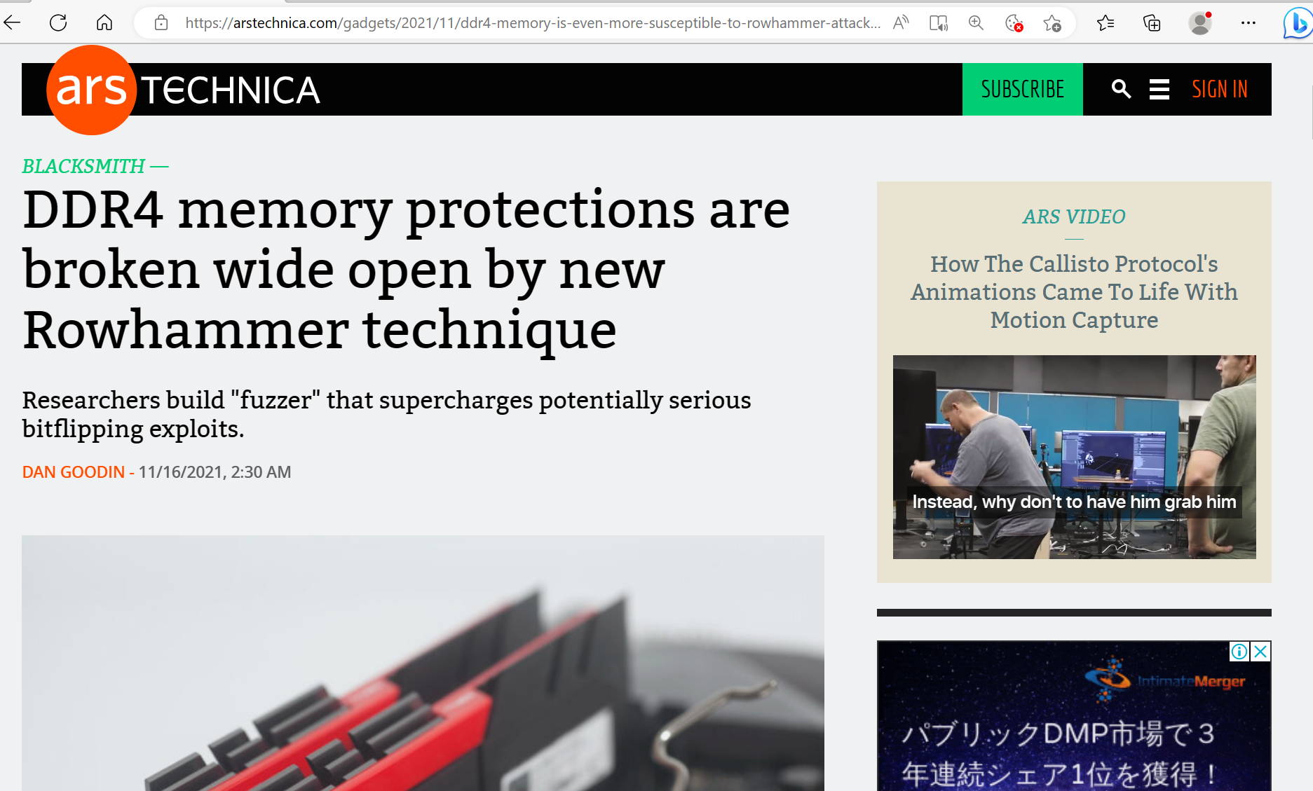




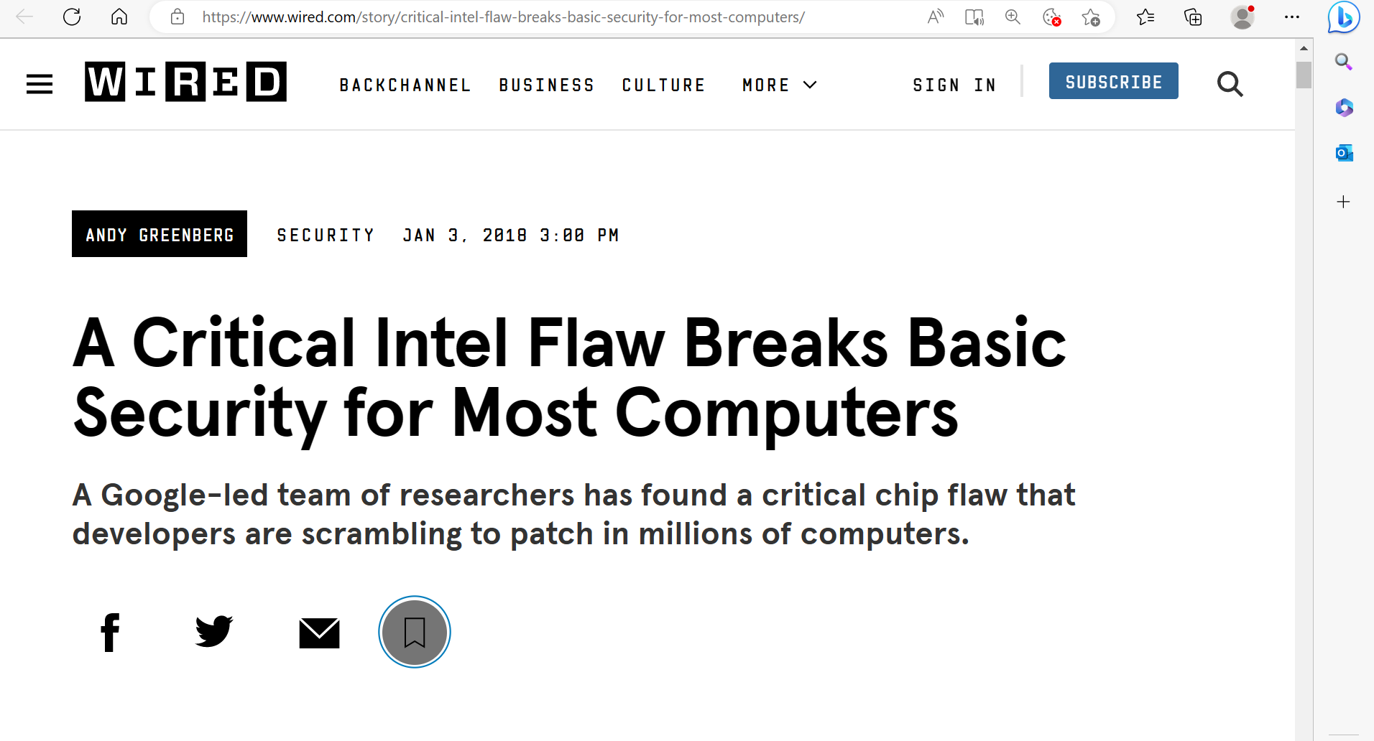
Reality Kicking In

Slide 13
Learning Outcomes
Diagnose microarchitectural vulnerabilities
Assess software for resilience against microarchitectural vulnerabilities
Design and program proof-of-concept exploits of vulnerable software and hardware
Design and implement countermeasures for software executing on vulnerable hardware

Slide 14
Introduction to x86 Assembly

Slide 15
Execution Model
Fetch
Decode
Execute
CPU
RIP
XOR EAX, EAX
0
2⁴⁷-1
0x31 0xc0 0x01 0xc6
0x31 0xc0
Memory

Slide 16

Instruction Format
INSTR DEST, SRC
XOR EAX, EAX
EAX ← EAX $⊕$ EAX

Slide 17
Registers
General Purpose
Special
RIP
RFLAGS
RAX
RBX
RCX
RDX
RBP
RSI
RDI
RSP
R8
R9
R10
R11
R12
R13
R14
R15
“General purpose” is a bit of a stretch
Many more
Floating point
MSR
Control registers

Slide 18
GP Registers
Register | Low 32 | Low 16 | Low 8
RAX | EAX | AX | AL
RBX | EBX | BX | BL
RCX | ECX | CX | CL
RDX | EDX | DX | DL
RBP | EBP | BP
RSI | ESI | SI
RDI | EDI | DI
RSP | ESP | SP
R8 | R8D | R8W | R8L
R9 | R9D | R9W | R9L
R10 | R10D | R10W | R10L
R11 | R11D | R11W | R11L
R12 | R12D | R12W | R12L
R13 | R13D | R13W | R13L
R14 | R14D | R14W | R14L
R15 | R15D | R15W | R15L
Can address part of the register.
Weird names
Weirder semantics

Slide 19
Instruction Format
INSTR DEST, SRC
XOR EAX, EAX
EAX ← EAX $⊕$ EAX

Slide 20

Instruction Format
INSTR DEST, SRC
XOR EAX, EAX
XOR ESI, ESI
EAX ← EAX $⊕$ EAX
ESI ← ESI $⊕$ ESI

Slide 21

Instruction Format
INSTR DEST, SRC
XOR EAX, EAX
XOR ESI, ESI
INC ESI
EAX ← EAX $⊕$ EAX
ESI ← ESI $⊕$ ESI
ESI ← ESI $+$ 1

Slide 22

Instruction Format
INSTR DEST, SRC
XOR EAX, EAX
XOR ESI, ESI
INC ESI
ADD EAX, ESI
EAX ← EAX $⊕$ EAX
ESI ← ESI $⊕$ ESI
ESI ← ESI $+$ 1
EAX ← EAX $+$ ESI

Slide 23

Instruction Format
INSTR DEST, SRC
XOR EAX, EAX
XOR ESI, ESI
INC ESI
ADD EAX, ESI
CMP ESI, 10
EAX ← EAX $⊕$ EAX
ESI ← ESI $⊕$ ESI
ESI ← ESI $+$ 1
EAX ← EAX $+$ ESI
ESI $==$ 10

Slide 24
Flags
Bits in the RFLAGS register
Store information on last operation (that affects flags)
CF – Carry
ZF – Zero
SF – Sign
OF – Signed integer overflow

Slide 25
Instruction Format
INSTR DEST, SRC
XOR EAX, EAX
XOR ESI, ESI
Label:
INC ESI
ADD EAX, ESI
CMP ESI, 10
JNE Label
EAX ← EAX $⊕$ EAX
ESI ← ESI $⊕$ ESI
ESI ← ESI $+$ 1
EAX ← EAX $+$ ESI
ESI $==$ 10

Slide 26
Instructions
MOV – moves between registers or to/from memory
CMOVcc – Conditional move e.g. CMOVNZ moves if the zero flag is not set
PUSH/POP – move to/from [RSP] and change RSP
ADD/SUB/ADC/SBC – Add/subtract without/with carry
CMP – compare
AND/OR/NOT/XOR – Bitwise ops
JMP – unconditional jump
Jcc – conditional jump
CALL/RET – Call subroutine/Return

Slide 27
Memory
Linear address space
For our purposes 0 – 2⁴⁷-1
OS decides which addresses are valid
Addressing components:
Displacement: 8, 16, or 32 bit constant
Base: register or 0
Index: register or 0
Scale: 1, 2, 4, or 8
address = disp + base + scale*index
LEA – load effective address
Byte order: Little endian
Example: MOV R8W, 1234[8*RAX+RCX]
Moves word at address 8*RAX+RCX+1234 to R8W

Slide 28
Execution stack
RSP points to the top of the stack
Grows downward – push decreases RSP
CALL – Pushes RIP to the stack and sets RIP to the new location
RET – Pops RIP from the stack
Calling convention:
Arguments: RDI, RSI, RDX, RCX, R8, R9
Return value: RAX
Scratch: R10, R11
XOR EAX, EAX
XOR ESI, ESI
Label:
INC ESI
ADD EAX, ESI
CMP ESI, EDI
JNE Label
RET

Slide 29
Inline Assembly
Template: Assembly code
Outputs and inputs: map to program variables
Clobber: locations (registers or memory) that are changed by the code
volatile: indicates that there are side effects
asm [volatile] (template:
outputs: [inputs: [clobber]])
static inline uint64_t rdtscp() {
uint32_t low, high;
asm volatile (
"RDTSCP":
"=a" (low), "=d" (high):
:
"ecx");
return (((uint64_t)high) << 32)
| low;
}
RDTSCP – Read time-stamp counter and processor ID
EAX – low 32 bits; EDX – high 32 bits; ECX – processor ID

Slide 30
Intrinsics
C “functions” that provide an API to assembly instructions.
#include <x86intrin.h>
__rdtscp(void *pid)
_mm_clflush(void *addrs)
_mm_lfence()
_mm_mfence()

Slide 31
Introduction to the Design of Modern CPUs

Slide 32
Instruction Pipelining
Nominally, the processor executes instructions one after the other
Instruction execution consists of multiple steps
Each uses a different unit
Instruction Fetch
Instruction Fetch
Instruction Fetch
Instruction Decode
Instruction Decode
Instruction Decode
Execute
Execute
Execute
Memory
Memory
Memory
Write Back
Write Back

Slide 33
Instruction Pipelining
Nominally, the processor executes instructions one after the other
Instruction execution consists of multiple steps
Each uses a different unit
Pipelining increases utilisation by executing steps of multiple instructions
Instruction Fetch
Instruction Decode
Execute
Memory
Instruction Fetch
Instruction Fetch
Instruction Decode
Instruction Decode
Execute
Execute
Memory
Memory
Write Back
Write Back
Instruction Fetch
Instruction Fetch
Instruction Fetch
Instruction Decode
Instruction Decode
Instruction Decode
Execute
Execute
Execute
Memory
Memory
Memory
Write Back
Write Back
Instruction Fetch
Instruction Fetch
Instruction Fetch
Instruction Decode
Instruction Decode
Instruction Decode
Execute
Execute
Execute
Memory
Memory
Memory
Write Back
Write Back
Instruction Fetch
Instruction Fetch
Instruction Decode
Instruction Decode
Execute
Execute
Memory
Memory
Write Back
Instruction Fetch
Instruction Fetch
Instruction Decode
Instruction Decode
Execute
Execute
Memory
Write Back

Slide 34
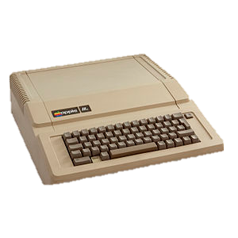

CPU vs. Memory
Processor
Speed
Memory
Latency
1 MHz
500 ns
20×3700 MHz
50 ns

Slide 35
Bridging the gap
Cache utilises locality to bridge the gap
Divides memory into lines
Stores recently used lines
In a cache hit, data is retrieved from the cache
In a cache miss, data is retrieved from memory and inserted to the cache
Processor
Cache
Memory
Notes:
Another thing that changed since my Apple // days is the processor speed. My apple 2 ran at 1 MHz. My mac runs at 2GHz. Memory speed, however, has not fared so well. The memory on my apple needed half a clock cycle to produce data, whereas modern computers require about 200. When the processor reads from memory it needs to wait. <click> and if it needs to read from the same location again it needs to wait again. <click>. So, we have a speed gap between the processor and the memory.
The cache is the part of the processor that bridges this gap. It is a small memory that is included within the processor. Being small, being closer to the execution core and using more expensive technologies than the main memory mean that the cache is much faster than the memory. On intel the spead ranges from 4 to 50 cycles, depending on the level of cache.
Yada yada

Slide 36
Set Associative Caches
Memory lines map to cache sets. Multiple lines map to the same set.
Sets consist of ways. A memory line can be stored in any of the ways of the set it maps to.
When a cache miss occurs, one of the lines in the set is evicted.
Sets
Ways
Memory

Slide 37
A Sample Program
baseSqr = base * base
heightSqr = height * height
hypotenuse = sqrt(heightSqr + baseSqr)

Slide 38
Nominal program execution
CPU
load base, r1
load height, r2
mul r1, r1, r3
mul r2, r2, r4
add r3, r4, r3
sqrt r3, r3
store r3, hypotenuse
mul r1, r2, r3
div r3, 2, r3
store r3, area
r1:
r2:
r3:
r4:

Slide 39
Nominal program execution
CPU
load base, r1
load height, r2
mul r1, r1, r3
mul r2, r2, r4
add r3, r4, r3
sqrt r3, r3
store r3, hypotenuse
mul r1, r2, r3
div r3, 2, r3
store r3, area
r1: 4
r2:
r3:
r4:

Slide 40
Nominal program execution
CPU
load base, r1
load height, r2
mul r1, r1, r3
mul r2, r2, r4
add r3, r4, r3
sqrt r3, r3
store r3, hypotenuse
mul r1, r2, r3
div r3, 2, r3
store r3, area
r1: 4
r2: 3
r3:
r4:

Slide 41
Nominal program execution
CPU
load base, r1
load height, r2
mul r1, r1, r3
mul r2, r2, r4
add r3, r4, r3
sqrt r3, r3
store r3, hypotenuse
mul r1, r2, r3
div r3, 2, r3
store r3, area
r1: 4
r2: 3
r3: 16
r4:

Slide 42
Execution dependencies
load base, r1
load height, r2
mul r1, r1, r3
mul r2, r2, r4
add r3, r4, r3
sqrt r3, r3
store r3, hypotenuse
mul r1, r2, r3
div r3, 2, r3
store r3, area

Slide 43
Out of Order Execution
CPU
load base, r1
load height, r2
mul r1, r1, r3
mul r2, r2, r4
add r3, r4, r3
sqrt r3, r3
store r3, hypotenuse
mul r1, r2, r3
div r3, 2, r3
store r3, area
r1:
r2:
r3:
r4:

Slide 44
Out of Order Execution
CPU
load base, r1
load height, r2
mul r1, r1, r3
mul r2, r2, r4
add r3, r4, r3
sqrt r3, r3
store r3, hypotenuse
mul r1, r2, r3
div r3, 2, r3
store r3, area
r1:
r2:
r3:
r4:
Start executing first load load

Slide 45
Out of Order Execution
Suppose height is in the cache and second load terminates first
CPU
load base, r1
load height, r2
mul r1, r1, r3
mul r2, r2, r4
add r3, r4, r3
sqrt r3, r3
store r3, hypotenuse
mul r1, r2, r3
div r3, 2, r3
store r3, area
r1:
r2:
r3:
r4:
Start executing second load

Slide 46
Out of Order Execution
CPU
load base, r1
load height, r2
mul r1, r1, r3
mul r2, r2, r4
add r3, r4, r3
sqrt r3, r3
store r3, hypotenuse
mul r1, r2, r3
div r3, 2, r3
store r3, area
r1:
r2:
r3:
r4:
Start executing the multiply instruction

Slide 47
Out of Order Execution
CPU
load base, r1
load height, r2
mul r1, r1, r3
mul r2, r2, r4
add r3, r4, r3
sqrt r3, r3
store r3, hypotenuse
mul r1, r2, r3
div r3, 2, r3
store r3, area
r1:
r2:
r3:
r4:
When the first load completes

Slide 48
Out of Order Execution
CPU
load base, r1
load height, r2
mul r1, r1, r3
mul r2, r2, r4
add r3, r4, r3
sqrt r3, r3
store r3, hypotenuse
mul r1, r2, r3
div r3, 2, r3
store r3, area
r1: 4
r2: 3
r3:
r4:
retire all completed instructions

Slide 49
Out of Order Execution
CPU
load base, r1
load height, r2
mul r1, r1, r3
mul r2, r2, r4
add r3, r4, r3
sqrt r3, r3
store r3, hypotenuse
mul r1, r2, r3
div r3, 2, r3
store r3, area
r1: 4
r2: 3
r3:
r4:
… and proceed

Slide 50
Out of Order Execution
CPU
load base, r1
load height, r2
mul r1, r1, r3
mul r2, r2, r4
add r3, r4, r3
sqrt r3, r3
store r3, hypotenuse
mul r1, r2, r3
div r3, 2, r3
store r3, area
r1: 4
r2: 3
r3:
r4:
Proceed
… and also here
Why not retire out-of-order?

Slide 51
Why not retire early
Early retire stores a result in the architectural state
CPU
load base, r1
load height, r2
mul r1, r1, r3
mul r2, r2, r4
add r3, r4, r3
sqrt r3, r3
store r3, hypotenuse
mul r1, r2, r3
div r3, 2, r3
store r3, area
r1:
r2: 3
r3:
r4:

Slide 52
Why not retire early
Early retire stores a result in the architectural state
CPU
load base, r1
load height, r2
mul r1, r1, r3
mul r2, r2, r4
add r3, r4, r3
sqrt r3, r3
store r3, hypotenuse
mul r1, r2, r3
div r3, 2, r3
store r3, area
r1:
r2: 3
r3:
r4:
A later fault leaves the processor in an inconsistent state!

Slide 53
How does it all work?
Frontend
Loads speculated instruction stream
Decodes to micro-ops
Dispatches to Execution Engine
Reorder instructions for retirement
Frontend
Loads speculated instruction stream
Decodes to micro-ops
Dispatches to Execution Engine
Reorder instructions for retirement
Execution Engine
Tracks dependencies between micro-ops
Executes ready micro-ops
Updates frontend on progress
Execution Engine
Tracks dependencies between micro-ops
Executes ready micro-ops
Updates frontend on progress
Memory Subsystem
Manages caches, memory order and coherency
Memory Subsystem
Manages caches, memory order and coherency
53

Slide 54
The frontend

Slide 55
The execution engine

Slide 56
The memory subsystem

Slide 57
Summary
X86-64 assembly – you need to know
Modern computers are complex
Next workshop: practise assembly
Next lecture: Flush+Reload
Reading: Yarom and Falkner, “Flush+Reload: a High Resolution, Low Noise, L3 Cache Side-Channel Attack,” USENIX Security 2014

